Slide 1
Bray Embedded Valves and Actuators
MEEN 402 Midterm Presentation
Avery Haynes, Locke Lehmann, Travis Carlson, Cody Sims, Zachary Walker, Michael Hager
2/26/2024
Notes:
Cody

Slide 2
Introduction
Bray is a premier manufacturer of flow control and automation products and accessories.
Assigned to work with Bray to:
Develop a method to internally measure valve position independent of an actuator
Measure actuator output torque to increase the valve's service life
Current solution: IOT Torque Bracket
Indirect measurement of actuator torque
Notes:
Cody

Slide 3
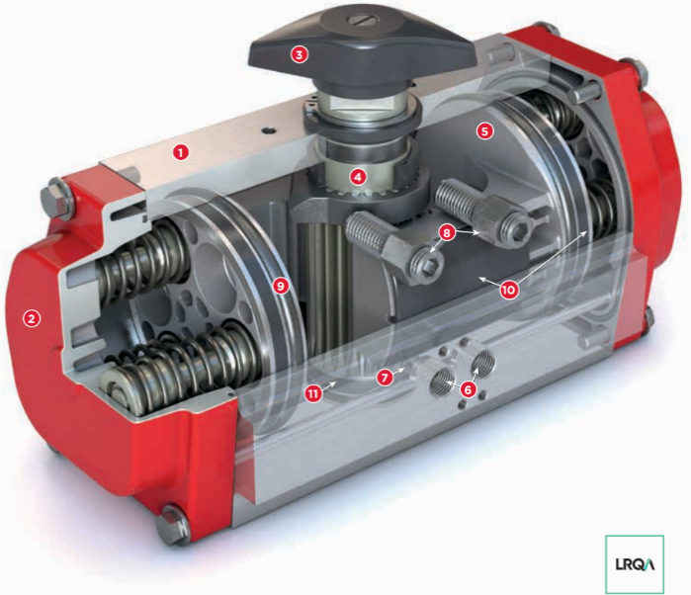
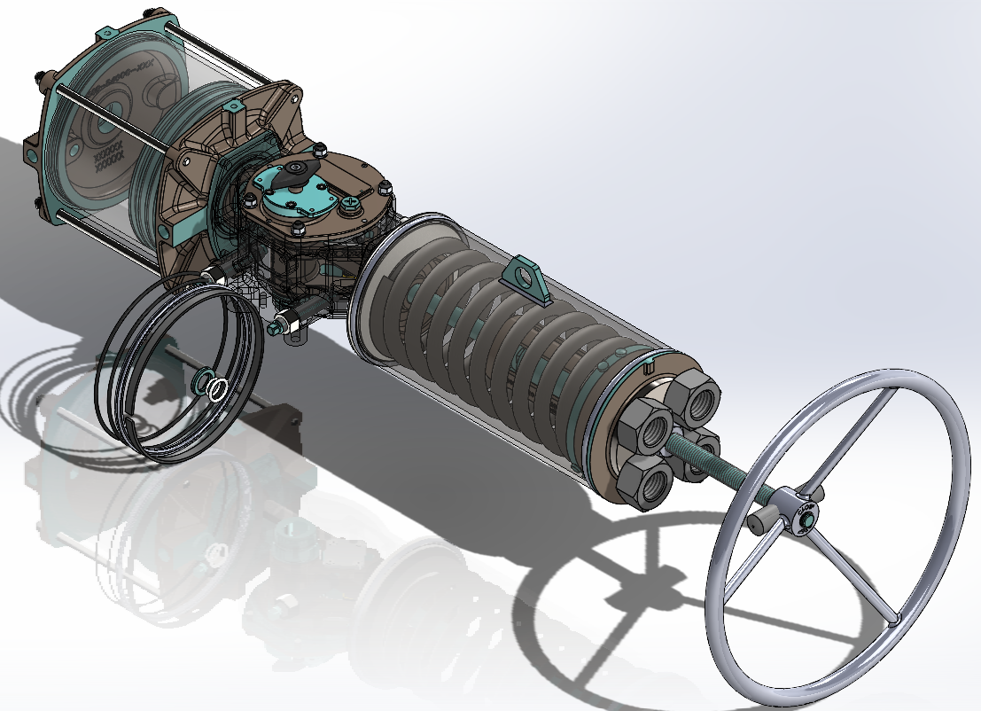
Relevant Products
S92 rack-and-pinion actuator S98 scotch-yoke actuator
Both are not yet “smart”
Notes:
Cody

Slide 4
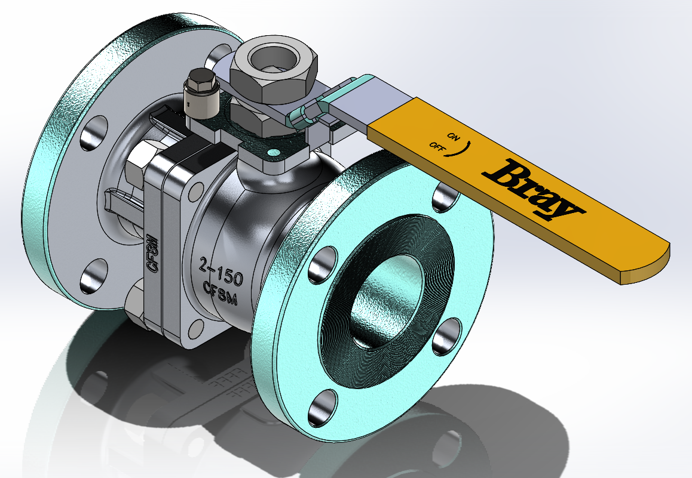
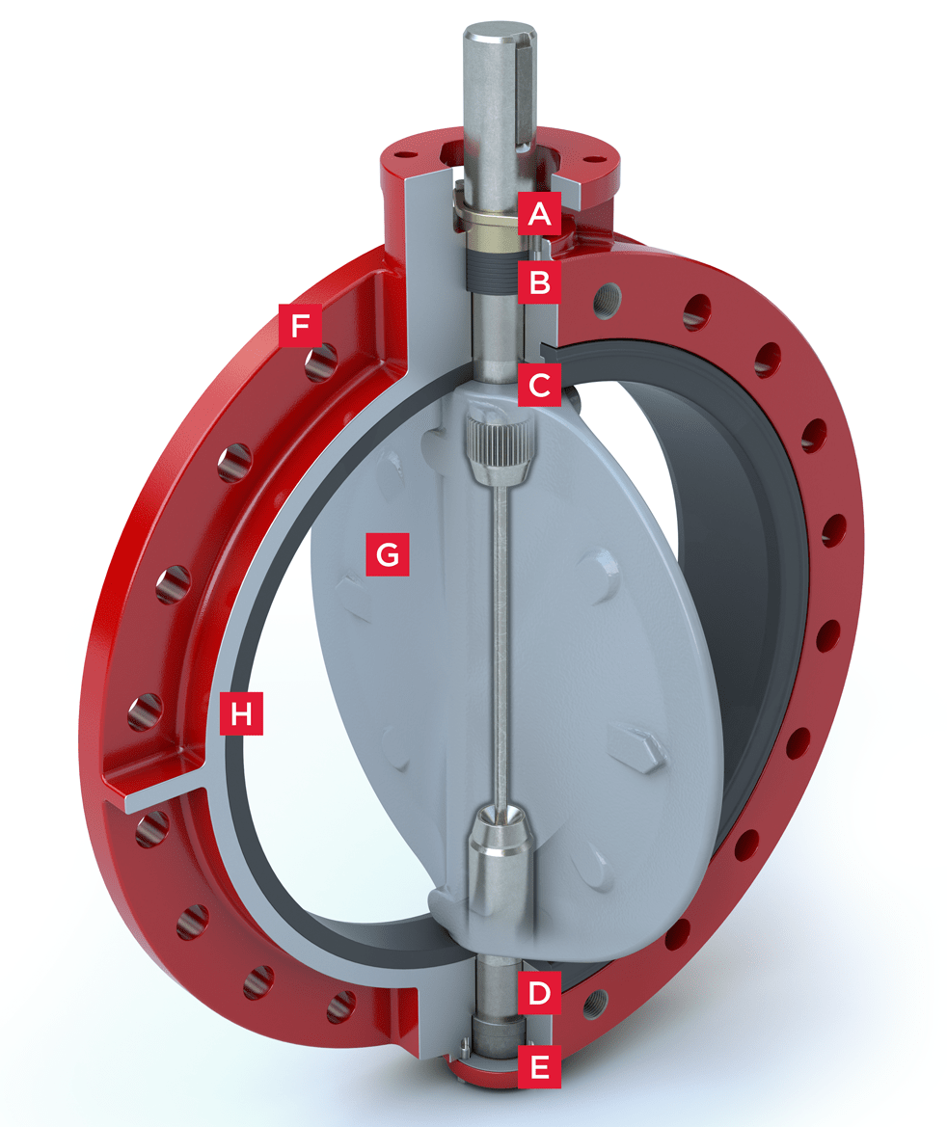
Relevant Products
Butterfly and ball valves
Focusing on ball valve due to higher engineering complexity.
Project solution should be agnostic to valve type.
Notes:
Cody

Slide 5
Customer Needs
# | Need | Importance
1 | Final product is embedded into the actuator casing | 1
2 | Product is scalable for different-sized valves | 2
3 | Product records and transmits sensor data | 1
4 | Works in a wide temperature range (-40℉-300℉) | 4
5 | Works under various pressures (100 psi - 740 psi) | 3
6 | Works for various fluid mediums | 4
7 | Measures actuator torque to < 5% error | 1
8 | Relatively short lead times for parts (3-4 weeks) | 2
9 | Determines true valve position independent of actuator | 1
10 | Works for both pneumatic and hydraulic actuators | 3
11 | Short time for calibrating the sensor | 3
Notes:
Travis

Slide 6
Concept Generation
Position | Rotary Potentiometer (voltage -> angular position) Hall effect sensor to identify rotation of a magnetized point Flow meters before and after valve Fluid turbulence measurement
Torque | Potentiometer (angular acceleration * I = torque) Strain gauges on shaft Strain gauges on stop bolts Spring scale Convert electric power generation to torque using time and rotation
Notes:
Travis

Slide 7
Concept Refinement
Only direct measurements preferred for better accuracy
Should not apply calculations to measured data
Ruled out any flow measurements
Most important solution characteristics
<5% error for torque, <2% error for position
No interference with system performance
Embedded nature
Notes:
Travis

Slide 8
Experimental Method
Test 2 concepts for each deliverable
Potentiometer and strain gauges are most promising, but others merit at least initial testing
Valve position concepts
Rotary Potentiometer
Hall Effect sensor
Actuator torque concepts
Cylindrical Strain Gauge
Electrical Energy Generation
Notes:
Travis

Slide 9
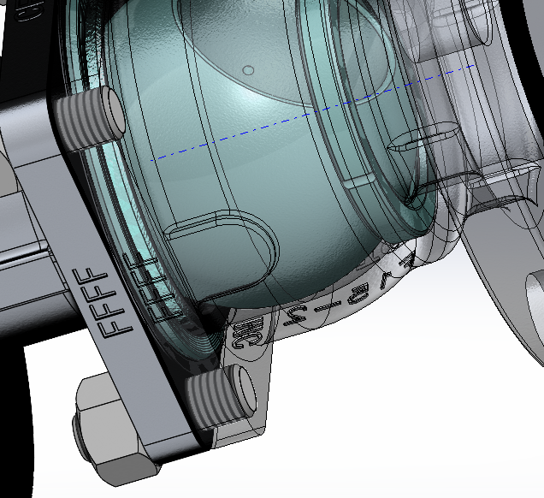
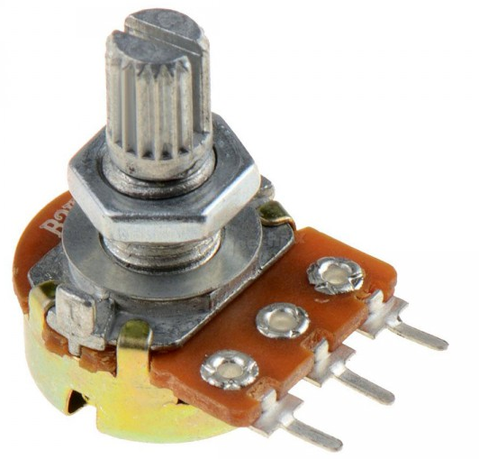
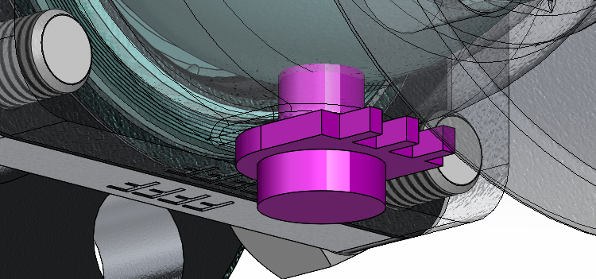
Design Details
Position: Rotary Potentiometer
Rotating part attached to ball or butterfly
Base fixed to valve casing
Hole through valve casing - must re-seal (Bray’s job)
Notes:
Zack

Slide 10
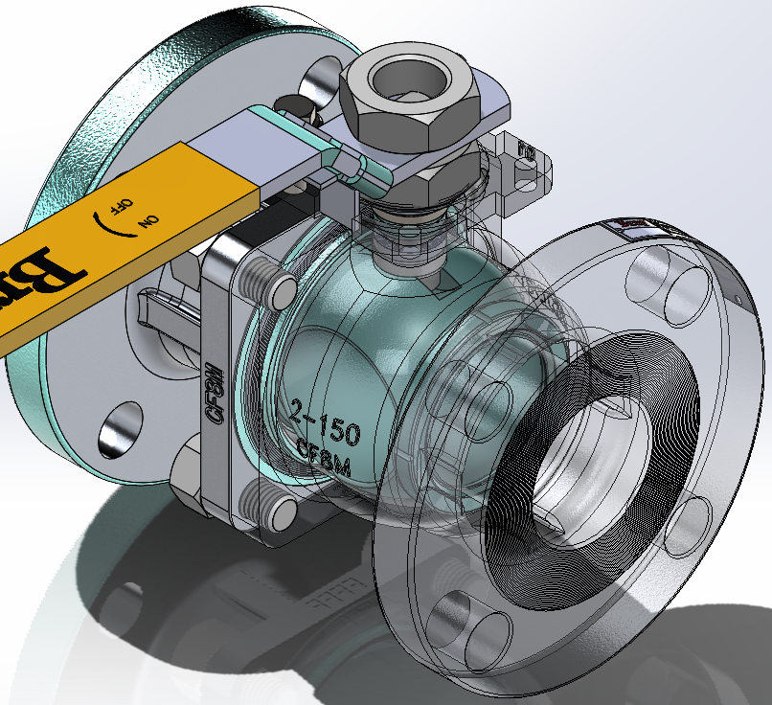
Design Details
Position: Hall Effect Sensor
Sensor tracks field from magnetized point on ball
Must determine “standard” magnetic fields at open/close
Must determine relationship between field readings and position
Embedded in casing or stem
Magnetic spot
Sensor in stem
Notes:
Zack

Slide 11
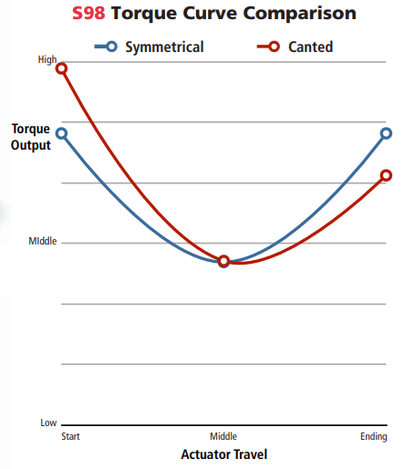
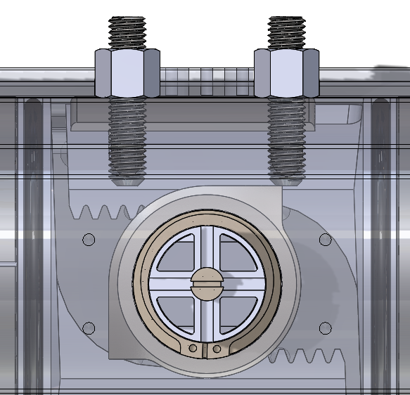
Design Details
Torque: Strain gauge in stop bolts
A, E
F
R
Notes:
Zack

Slide 12
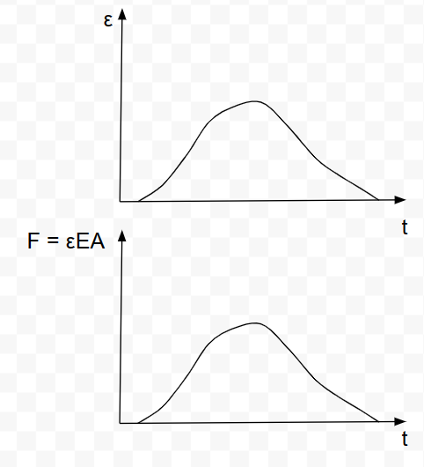
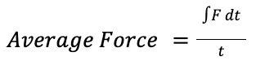
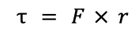
Design Details
Torque: strain gauge in stop bolts
Gauge records: strain (ε) vs. time (t)
Can record torque for every open/close motion and identify performance
Notes:
Zack

Slide 13
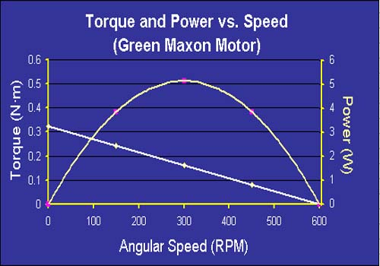
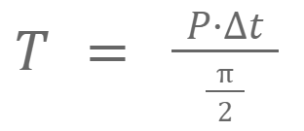
Design Details
Torque: Electric Motor
Torque units: Nm ← distance
Energy Units: J = Nm ← displacement
Conversion: E = T*rad
Radians known as π/2
Record Volts generated from motor rotation
Motor in line with a known resistance a total power can be found
Notes:
Zack

Slide 14
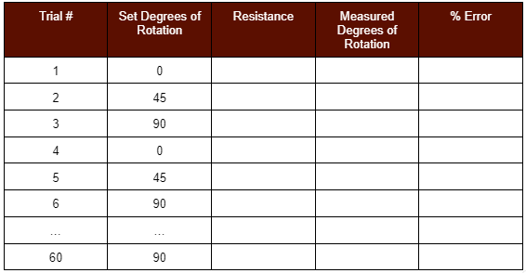
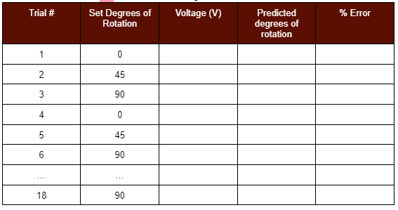
Validation Testing - Position
Hypothesis: Design can achieve below 2% error from the actual rotational position of the ball valve.
Independent Variables: Rotational position of the valve, surrounding temperature
Dependent variables: % Error
Hall Effect sensor
Potentiometer
Initial distance testing: 0, 2, 4, 6, …,20 mm
Notes:
Locke

Slide 15
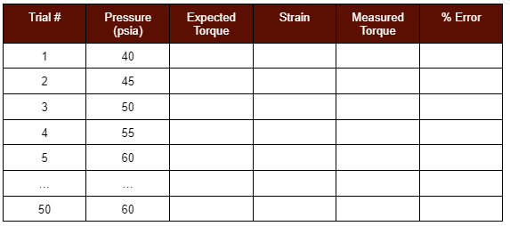
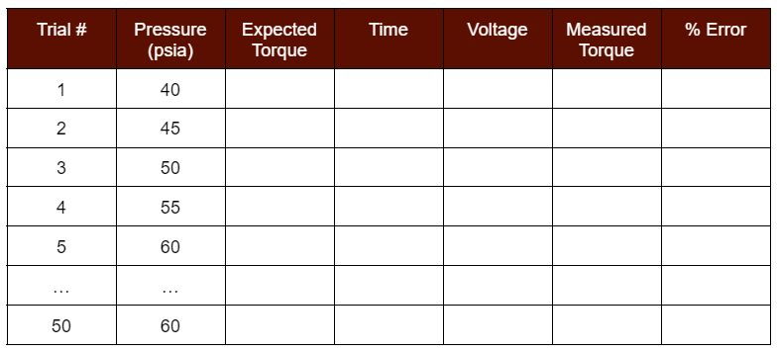
Validation Testing - Torque
Hypothesis: Design can achieve below 5% error from the actual torque of the actuator.
Independent variables: Temperature, Pressure
Dependent variables: % error
Bolt strain gauge
Motor EMF
Notes:
Locke

Slide 16
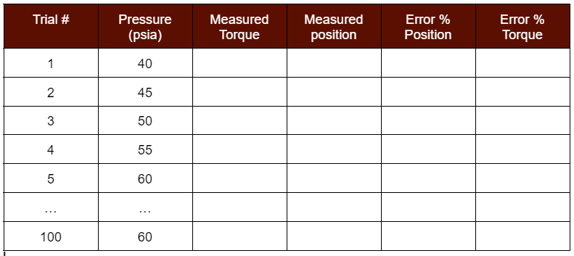
Validation Testing: Combined Concepts
Hypothesis: Design concepts together achieve the required error percent while under various pressures and temperatures.
Independent variables: pressure, temperature
Dependent variables: torque, position, error%
Will Temperature test at room temp, 100℉, and 40℉
Notes:
Locke

Slide 17
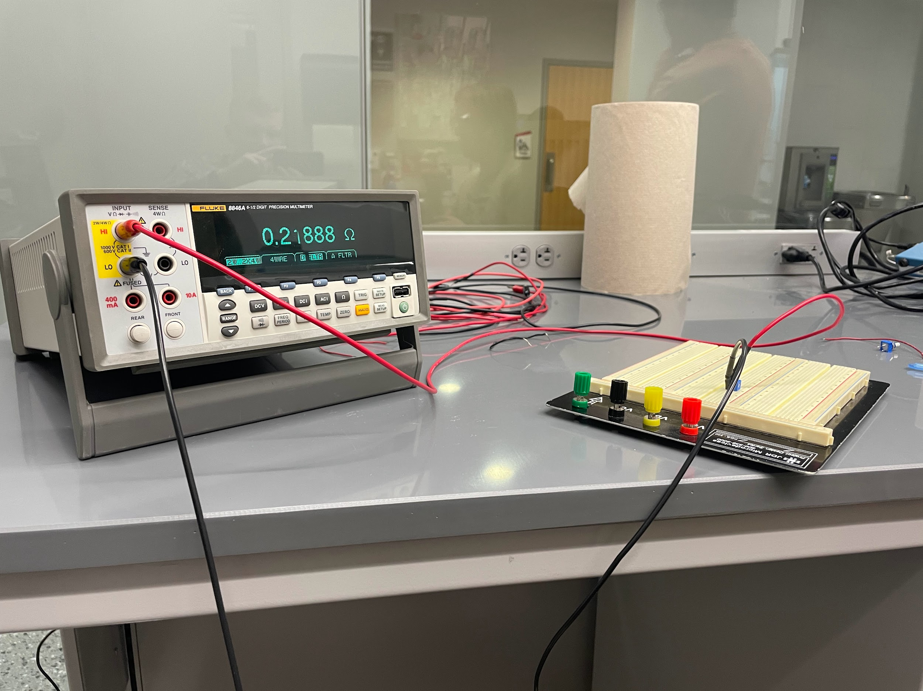
Potentiometer Validation
Position: Potentiometer
Tested to see correlation between resistance and position
Linear 10 KΩ pot met the <2% accuracy reqt.
Position (degrees) | Resistance (ohms) | Predicted Position (degrees) | error %
0 | 0.24 | -0.000024 | 0.24
270 | 94732 | 270.1 | 0.029
0 | 0.24 | -0.000024 | 0.24
270 | 94748 | 270.1 | 0.046
0 | 0.22 | -0.000081 | 0.81
270 | 94736 | 270.1 | 0.034
0 | 0.25 | 0.0000048 | 0.048
270 | 94806 | 270.3 | 0.11
0 | 0.25 | 0.0000048 | 0.048
270 | 94616 | 269.7 | 0.093
0 | 0.29 | 0.00012 | 1.2
270 | 94587 | 269.7 | 0.12
Notes:
Locke

Slide 18
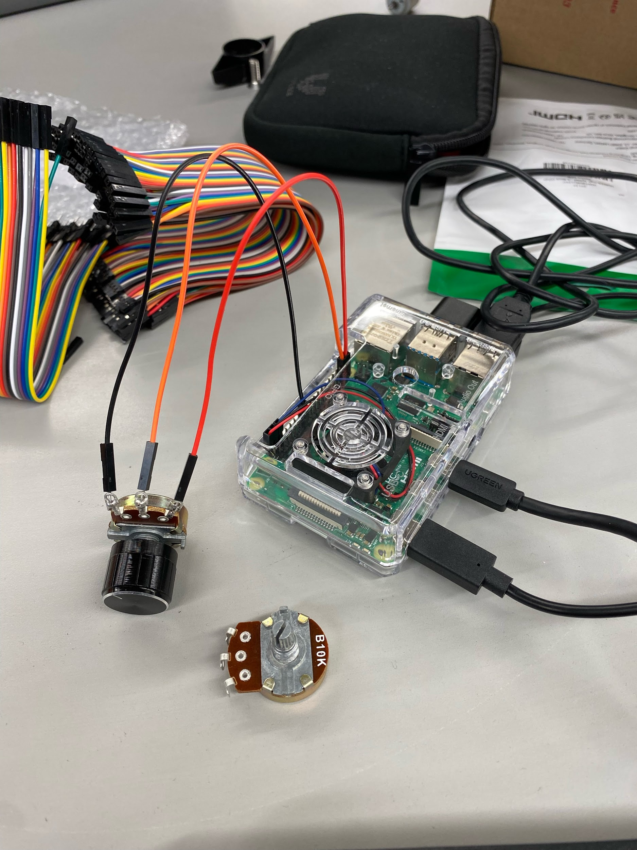
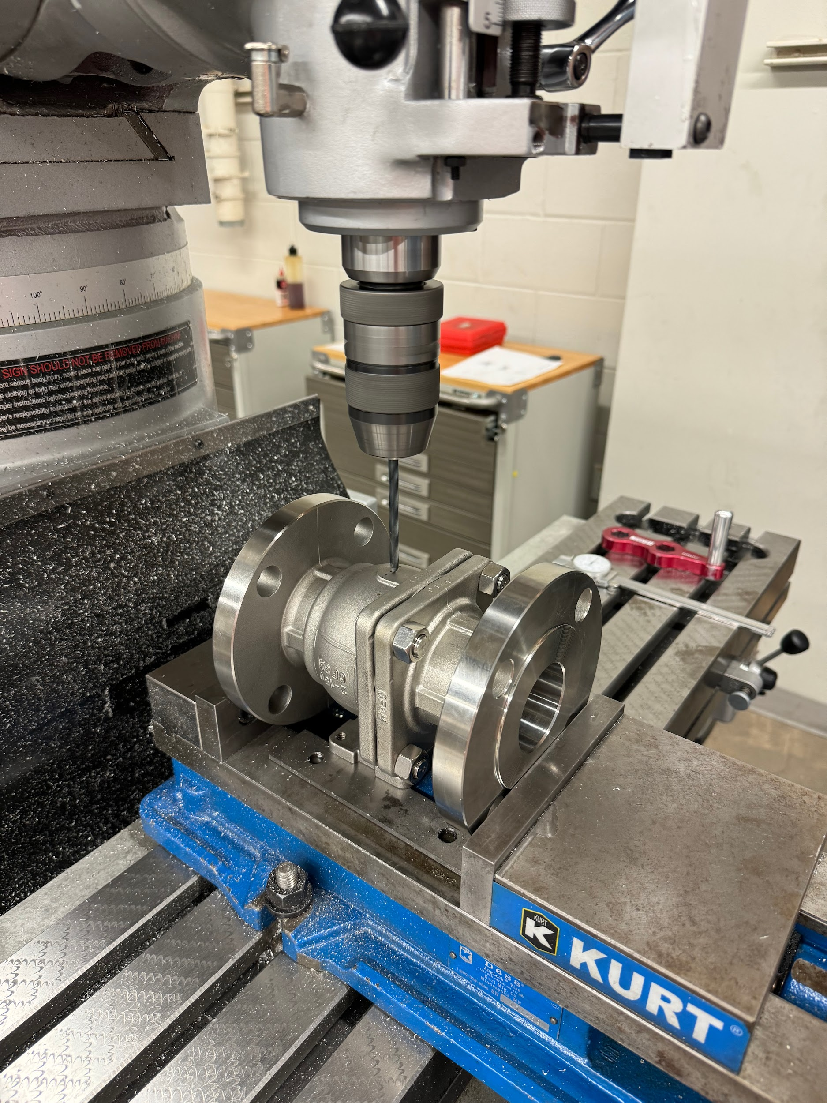
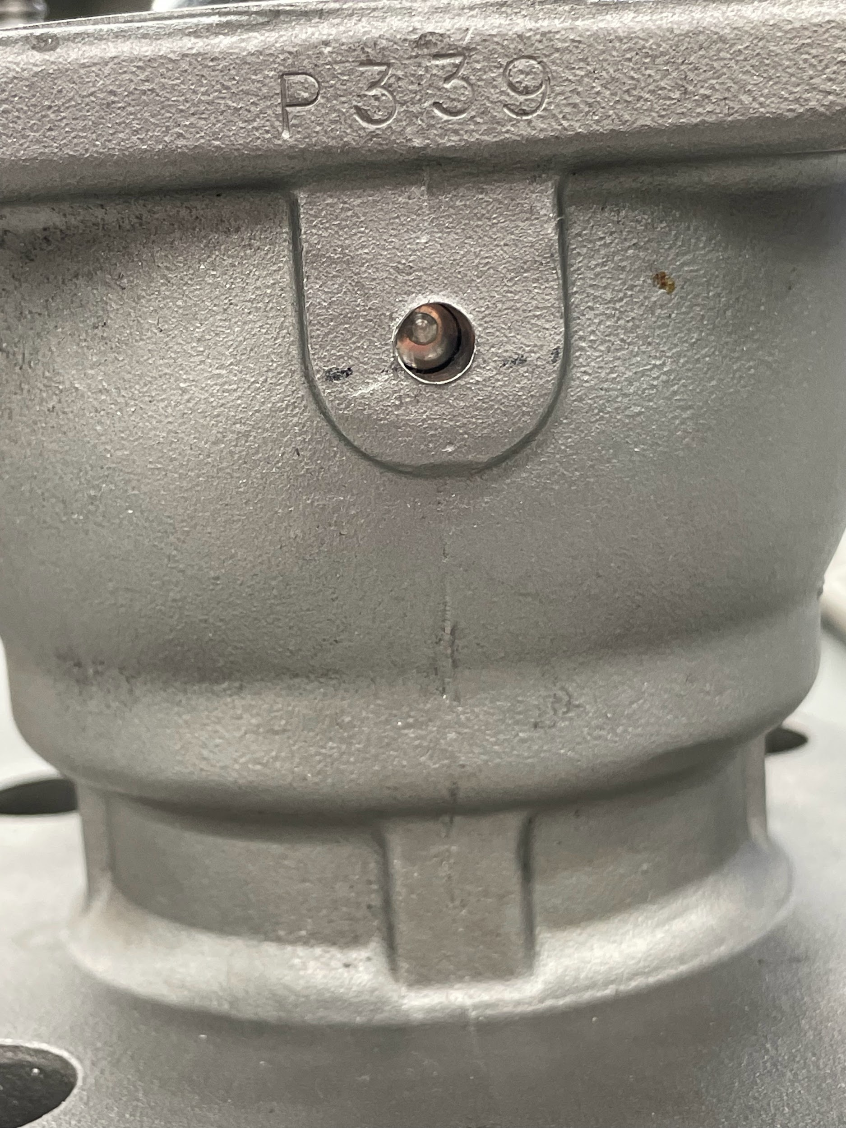
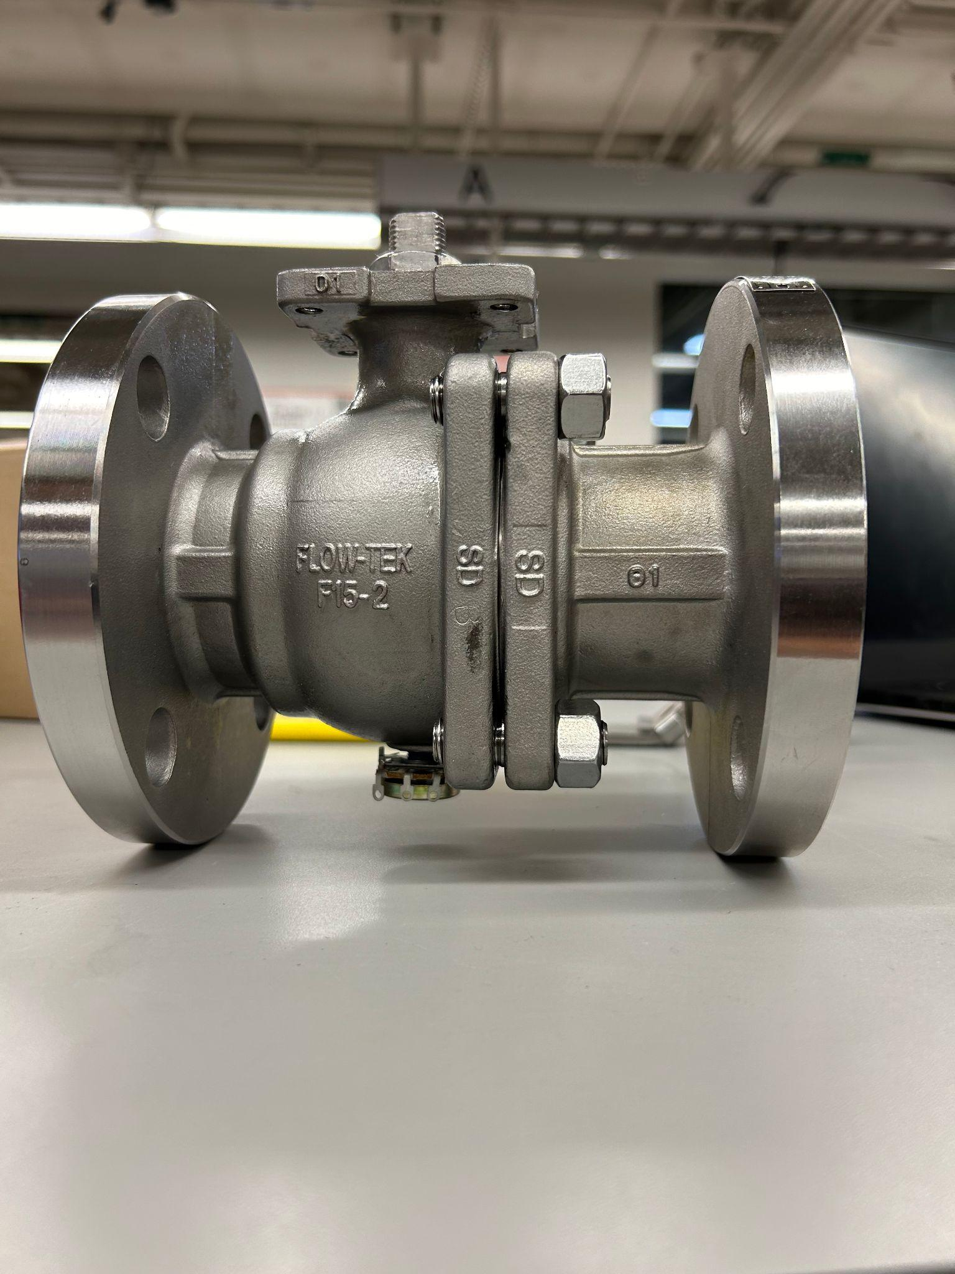
Potentiometer Status
Received potentiometers
Drilled hole in ball valve and inserted potentiometer
Attached potentiometer to Raspberry Pi
Remaining tasks
Attach Potentiometer to ADC converter
Test error readings
Notes:
Locke

Slide 19
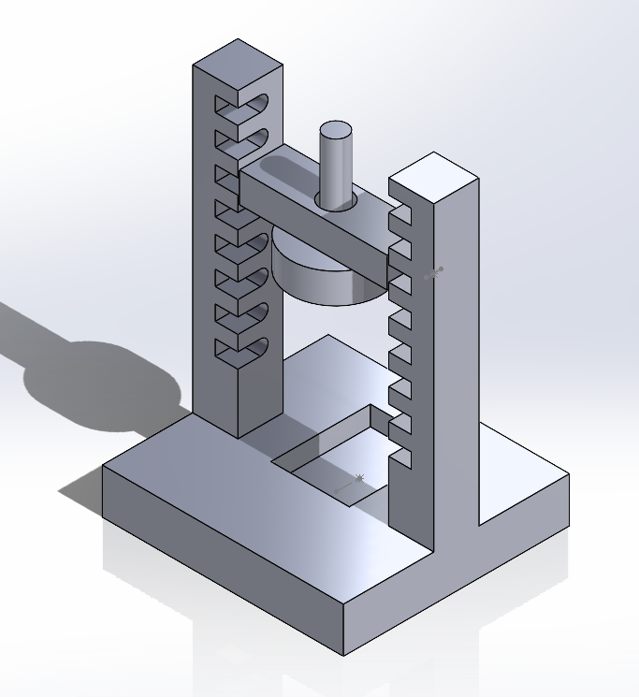
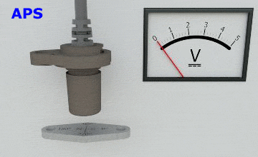
Hall Effect Status
Designed prototype to test sensor
with various air gaps between sensor and magnet
Will insert cast iron samples to measure impact of ferromagnetic metal interference has on the readings
Notes:
Locke

Slide 20
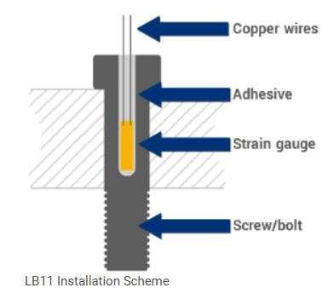
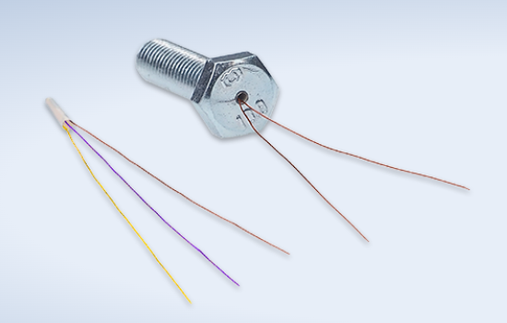
Strain Gauges Status
Strain Gauges & Adhesive ordered 2/26
Shipping from Germany
Verified gauges can be inserted into S92 Actuator
Requires 2mm hole drilled into the bolt
Gauge, adhesive, teflon inserted into hole
Entire bolt cured in an oven (140 F for 2 hours)
Remaining tasks
Verify data collection of stresses with Pi
Validation testing that design meets requirements
Construct casing
Notes:
Avery

Slide 21
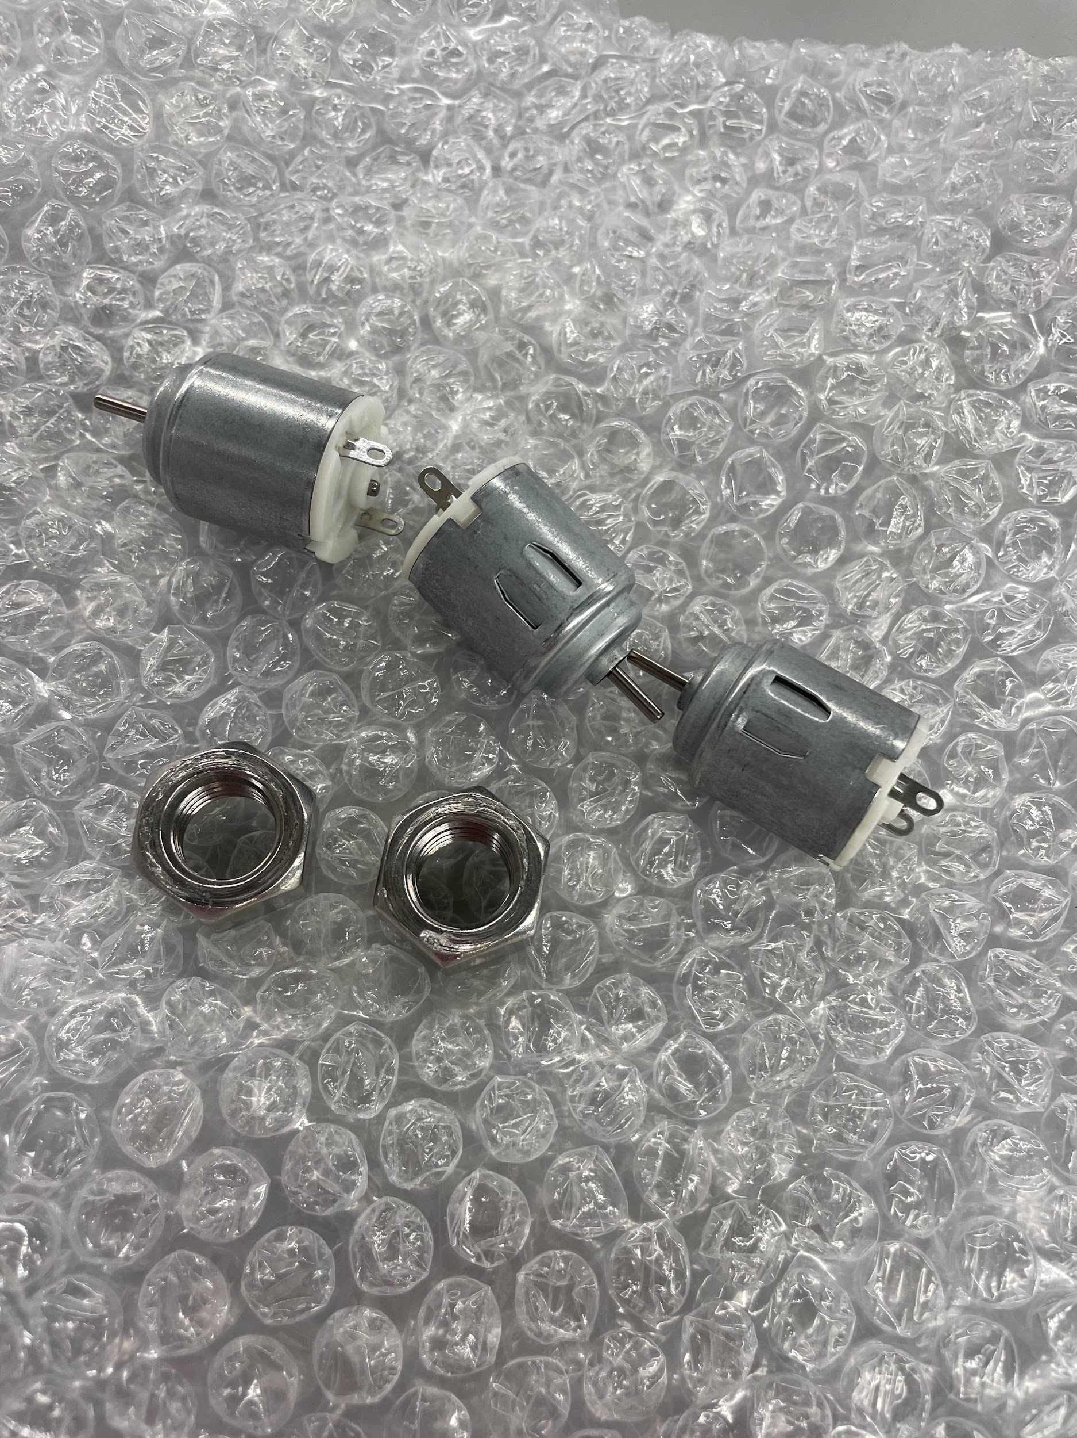
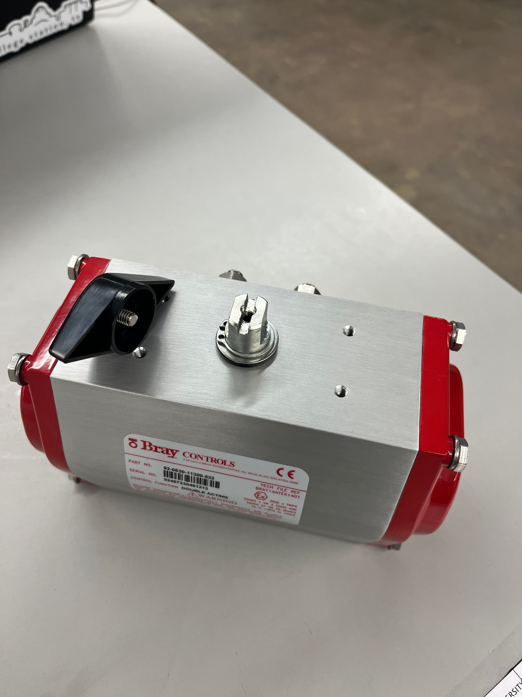
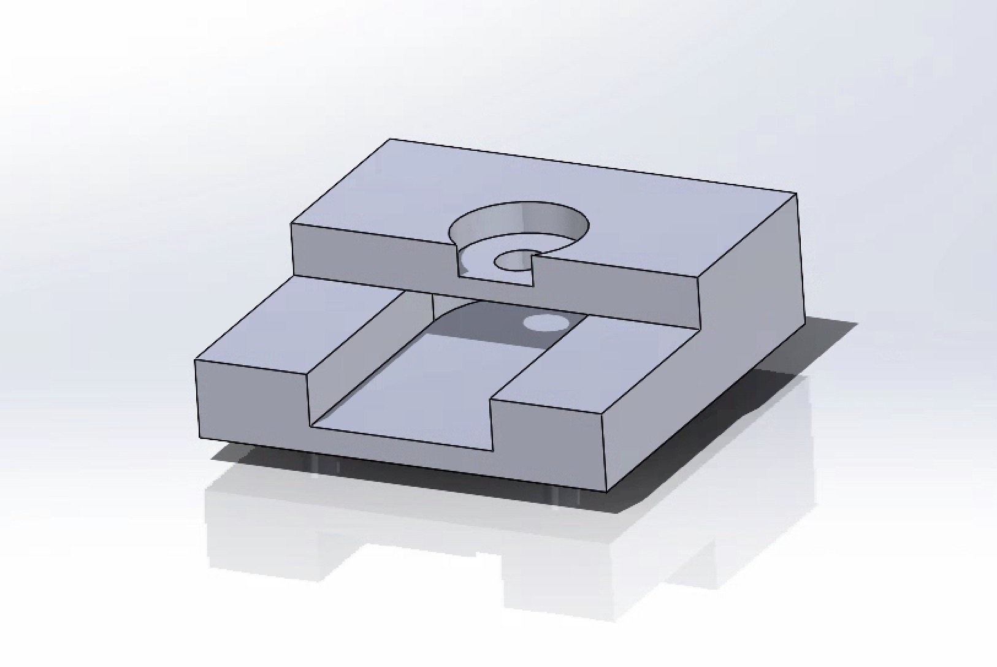
Motor EMF Status
Initial mounting bracket designed
Redesign to fit on top of actuator & validate
Awaiting arrival of ADC chips to measure back EMF with Raspberry Pi
Initial concept validated with multimeter
Remaining tasks
Test mounting methods
Verify data collection method
Validate measurement error of actuator torque
Notes:
Avery

Slide 22
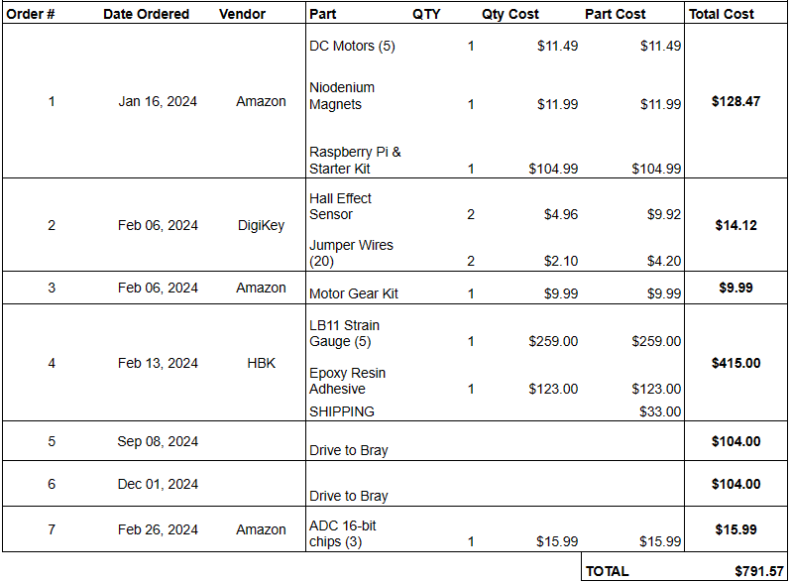
Expenses Status
Waiting on strain gauges and adhesive from HBK (# 4)
DigiKey order (#2) lost?
ADC Chips ordered and expected by end of week
Budget Update: $791.57 spent (out of $3,803 approved)
Notes:
Avery

Slide 23
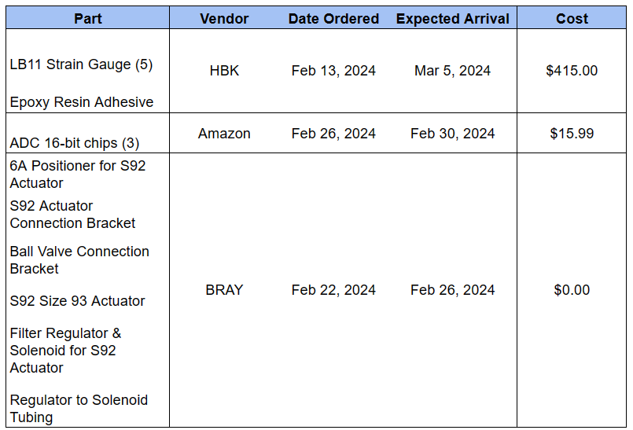
Pending Arrival
To be purchased:
Testing Rig Materials
Electrical Connections for solenoid valve
1-2 trips to Bray facilities (as needed)
Notes:
Avery

Slide 24
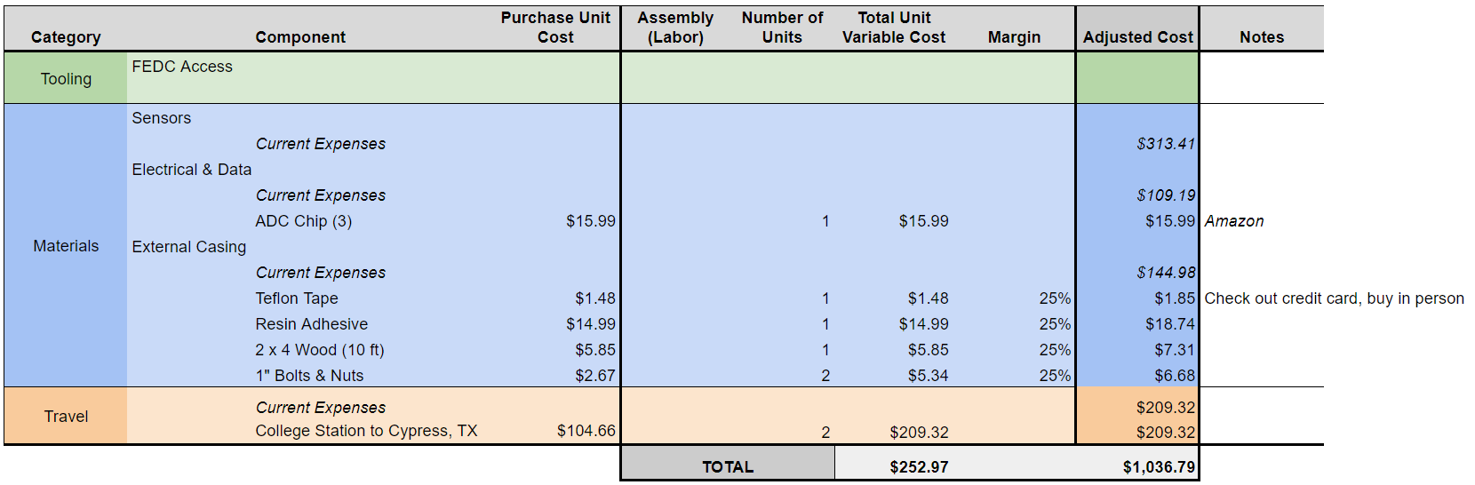
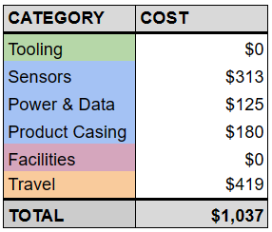
Budget Planning
Notes:
Avery

Slide 25
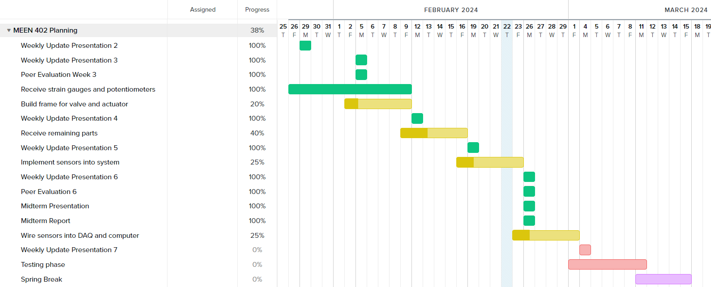
Gantt Chart
Notes:
Michael

Slide 26
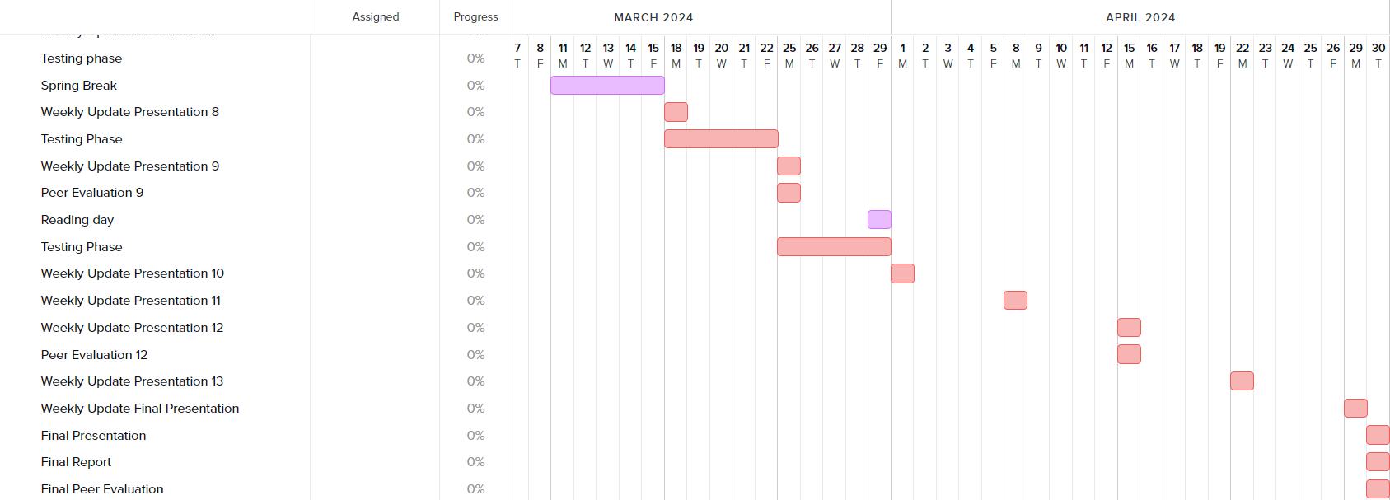
Gantt Chart
Notes:
Michael

Slide 27
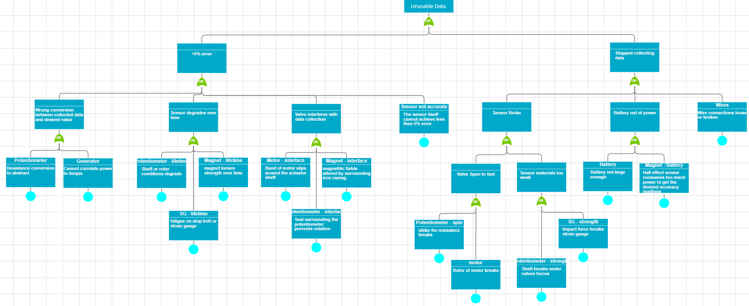
Risk Assessment
Notes:
Michael

Slide 28
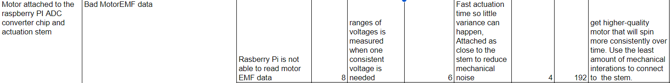
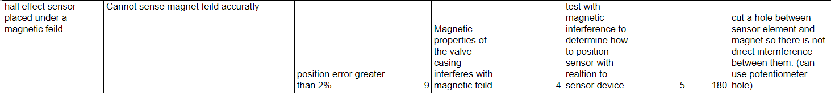
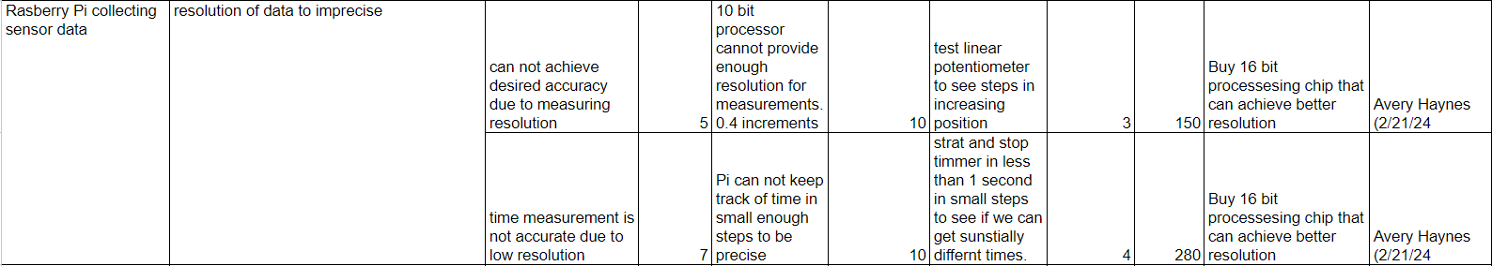
FMECA
Notes:
Locke

Slide 29
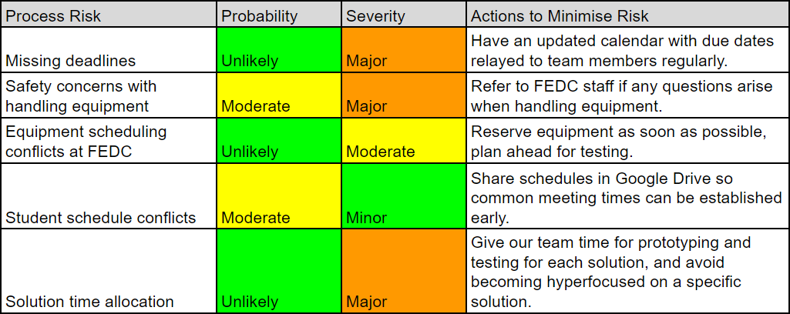
Process Risk Assessment
Notes:
Michael

Slide 30
Final Deliverables
Provide a solution for detecting valve positions and internal actuator torque
Solution scalable to varying actuator and valve sizes
Product is cost-effective and safe for the user
Validate which solutions best meet customer needs while minimizing error
Collaborate with Bray to create prototypes of solutions, which will undergo testing with their valves and actuators
Adhere to milestones and deadlines, allowing us to provide effective material for our upcoming reports
Notes:
Michael

Slide 31
Conclusions
Concepts to measure valve position
Rotary Potentiometer, Hall Effect Sensor
Concepts to measure actuator torque
Cylindrical Strain Gauge, EMF Generation
Spring Semester Goal
Develop, test, and validate design concepts and determine which best meets project deliverables.
Physical manufacturing/testing is underway and going well
Notes:
Michael

Slide 32
References
“Piping Codes and Valve Standards”. Valve Magazine, September 29, 2015,
https://www.valvemagazine.com/articles/piping-codes-and-valve-standards. Accessed 25 October 2023.
“Fluid Power Actuators Explained”. Rotork Fluid Systems, May 2016, https://www.rotork.com/uploads/documents-versions/24733/1/pub010-024-00_0516.pdf. Accessed 11 September 2023.
“Pneumatic Actuator: Series 92/93 Rack & Pinion Pneumatic”. Bray International, Inc, n.d., https://www.bray.com/valves-actuators-controls/actuators/pneumatic-actuator/series-92-93-pneumatic-actuator. Accessed 11 September 2023.
“Scotch Yoke Pneumatic Actuator: Series 98”. Bray International, Inc, n.d., https://www.bray.com/valves-actuators-controls/actuators/pneumatic-actuator/series-98-scotch-yoke-pneumatic-actuator. Accessed 11 September 2023.
“Mark-10 MTT03C-100 Hand-held Cap Torque Meter CAP-TT03-100”. ABQ Industrial, n.d., https://www.abqindustrial.net/store/mark-10-mtt03c-100-hand-held-cap-torque-meter-cap-tt03-100-100-lbf-in-capacity-p-807-op-1306_4671.html. Accessed 25 October 2023.
“Torque Sensor - Valve Torque Testing”. Futek Advanced Sensor Technology, n.d., https://www.futek.com/applications/Valve-Torque-Testing. Accessed 23 October 2023.
“A Comprehensive Guide on Butterfly Valve Vs Ball Valve”. Dombor Valve, 2021, https://www.dombor.com/ball-valve-vs-butterfly-valve/. Accessed 11 September 2023.
“Rotary Potentiometer - 10k Ohm, Linear”. Osoyoo, May 7, 2015, https://osoyoo.com/2017/05/07/rotary-potentiometer-10k-ohm-linear/. Accessed 29 October 2023.
https://urldefense.com/v3/__https://www.hbm.com/en/7452/cylindric-strain-gauges-for-measurements-in-bolts/?product_type_no=LB11*TB21*20Strain*20Gauges*20for*20Measuring*20in*20Screws*20&*20Bolts__;LyUlJSUlJSUl!!KwNVnqRv!D9Ef3vPu0aZQhc7RLKtv_F_0ptA4-baKgBz2qm5KfQ57GkAa8nQAN9R7XYwxzJueRnq8yxMvErTp04wVIMVGhQr57Ok-EDJCuA$

Slide 33
Questions?

